Slide 1
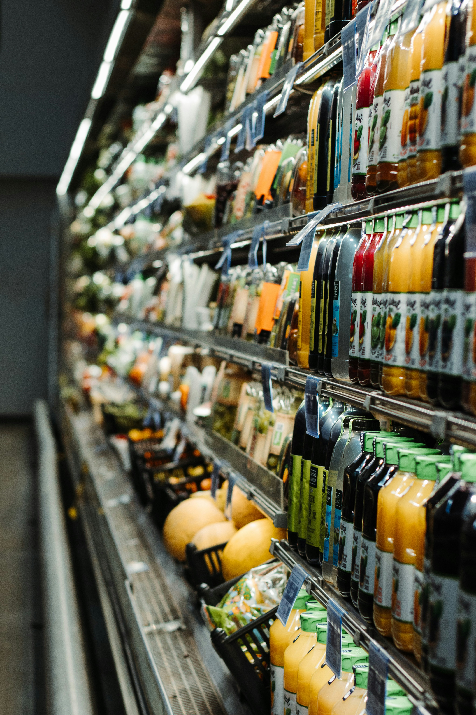
Superstore Sales Report
Name - Amit Ghosh
Date - 21/05/2024

Slide 2
Analyzing sales data for insights
A retail chain, Superstore, provides a wide range of essential items in every category. This report examines their sales data to uncover valuable insights that could enhance profitability and foster expansion.

Slide 3
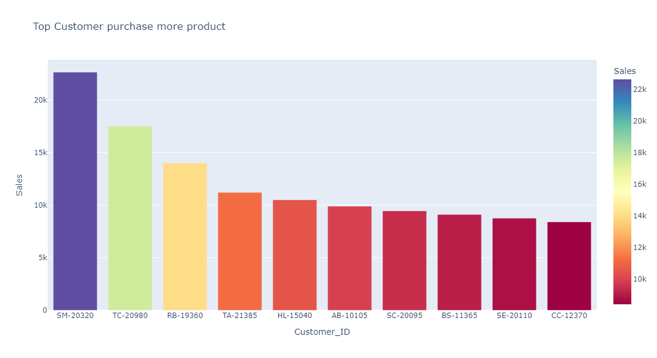
Top Customers
Who Drives Our Sales?
Rank 1 = Sean Miller customer id = ‘SM-20320’
Rank 2 = Tamara Chand customer id = ‘TC-20980’
Rank 3 = Raymond Buch customer id = ‘RB-19360’

Slide 4
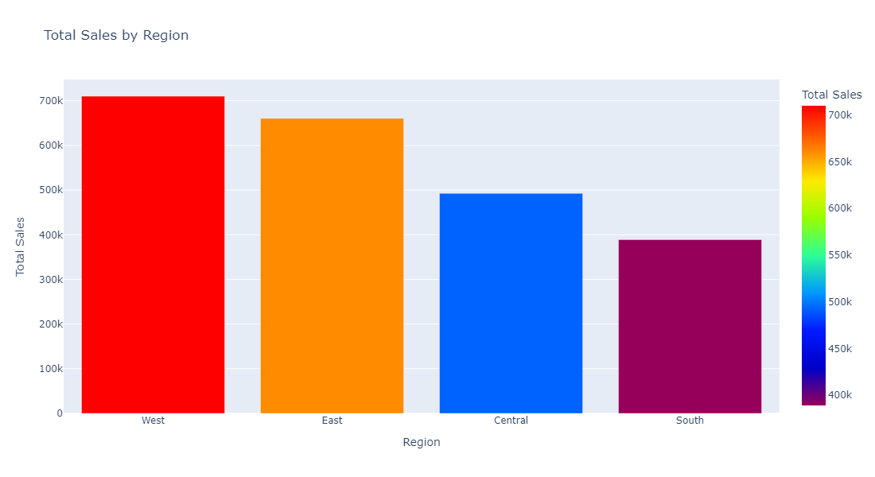
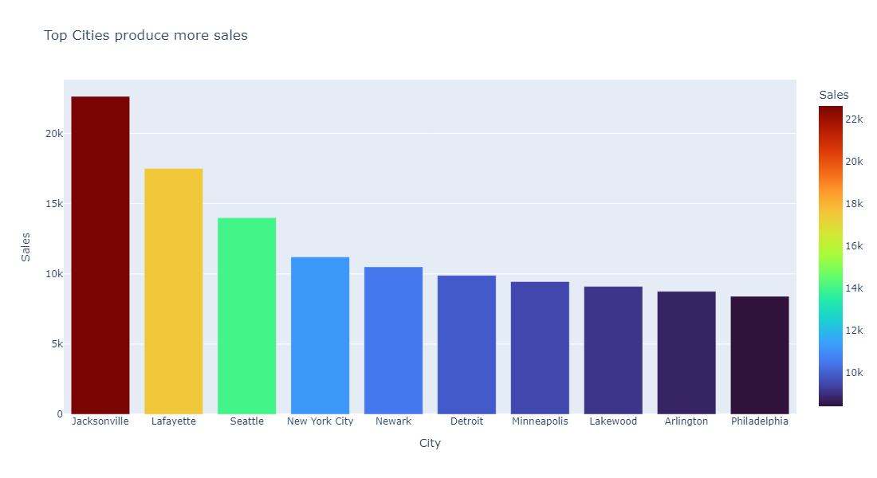
Top Cities & Regions
Where the Money Flows: Top Sales by City & Region?
Most sales generating region = West
Most sales generating city = Jacksonville

Slide 5
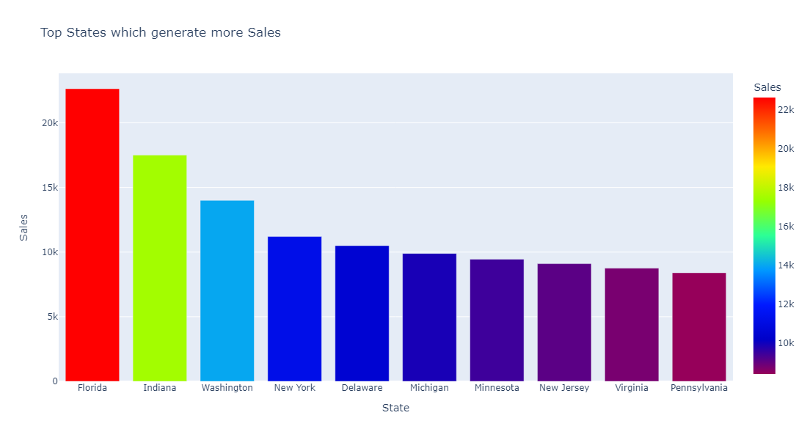
Top States
State of Sales: Top Performing States
Rank 1 = Florida
Rank 2 = Indiana
Rank 3 = Washington

Slide 6
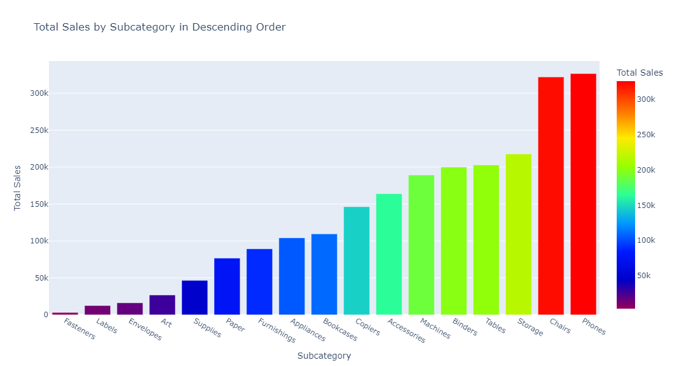
Top Subcategory wise Sales
Drilling Deeper: Sales Performance by Subcategory :-
Rank 1 = Phones
Rank 2 = Chairs

Slide 7
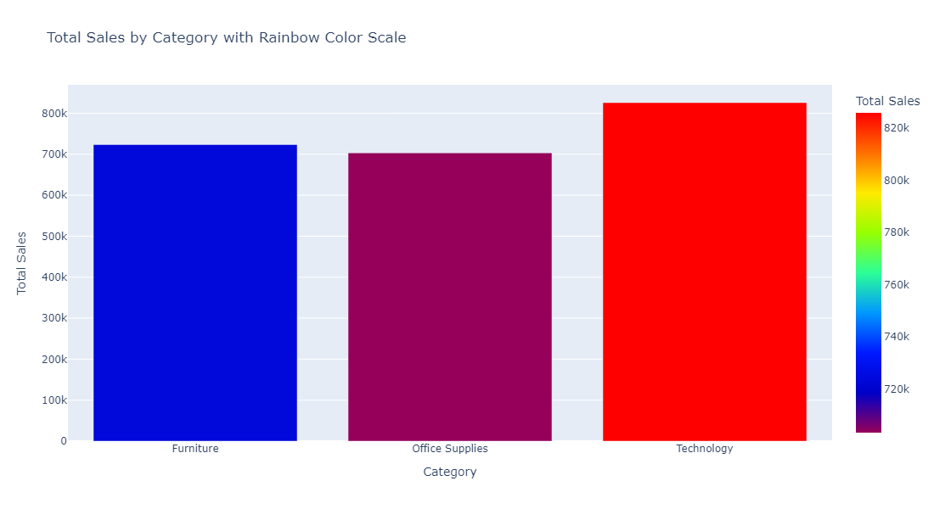
Top Category wise Sales
Sales Performance by Category :-
Rank 1 = Technology
Rank 2 = Furniture
Rank 2 = Office Supplies

Slide 8
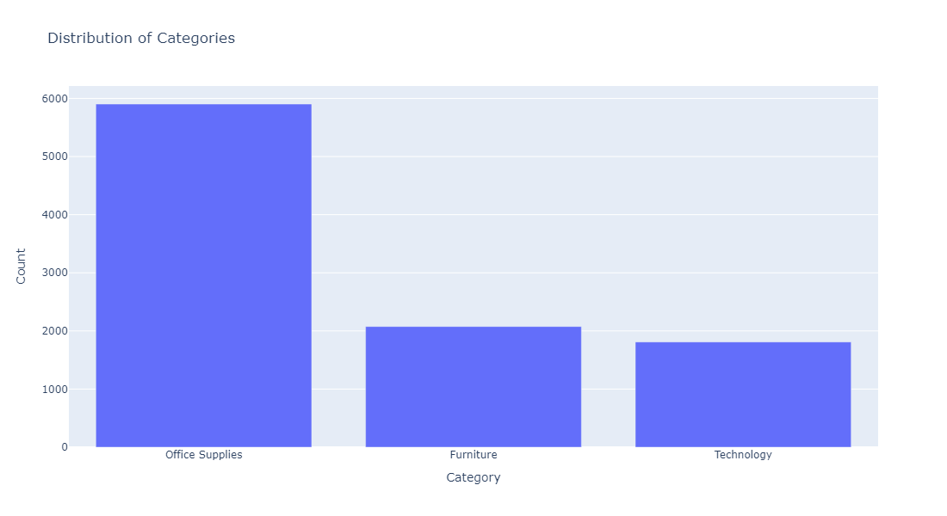
Distribution of Categories
Category Distribution :-
Rank 1 = Office Supplies
Rank 2 = Furniture
Rank 2 =Technology

Slide 9
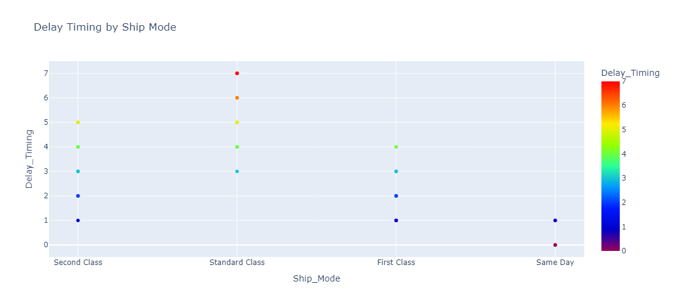
Efficiency of Ship Modes
Delay Timing :-
Same day (Max) = 1 (Min) = 0
First class (Max) = 4 (Min) = 1
Standard class (Max) = 5 (Min) = 1
Second class (Max) = 7 (Min) = 3

Slide 10
Conclusion:-
Name of the top customer = Sean Miller (who spend max),(Customer Id = SM-20320)
Most sales generating State = Florida
Most sales generating City = Jacksonville
Most sales generating Year = 2018
Most sales generating Category = Technology
Most sales generating Sub Category = Phone
Most sales generating Region = West
Efficiency of Ship Modes :
Same day (max) = 1 (Min)= 0
First class (max) = 4 (Min)= 1
Second class (max) = 5 (Min)= 1
Standard class (max) = 7 (Min)= 3

